Slide 1

What’s new in Azure Databricks
John Miner Data Architect
john.miner@insight.com

Slide 2
Purpose
As a data engineer, it is very hard to keep up with changes in the technology. Top tier companies are constantly enhancing their offerings to keep pace with their competitor.
Databricks was first released on AWS in 2015, Microsoft Azure in 2017 and GCP in 2021. The game changer was Delta format released in 2019 to gain transactional integrity with the Parquet data table format for Spark cloud workloads.
Today, we are going to talk about what is relatively (new) in Databricks.

Slide 3
Topics
Data Engineering (core concepts)
Workflows (before + after)
Autoloader
Delta Live Tables
Cloning

Slide 4
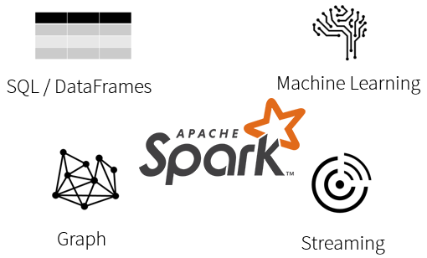
What is Spark?
Spark is a unified processing engine that can analyze big data using SQL, machine learning, graph processing or real-time stream analysis.

Slide 5
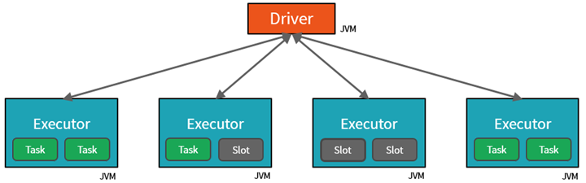
Databricks Cluster
By creating notebook Tasks, the Driver can assign units of work to Slots for parallel execution.
The Driver must also decide how to partition the data so that it can be distributed for parallel processing.

Slide 6
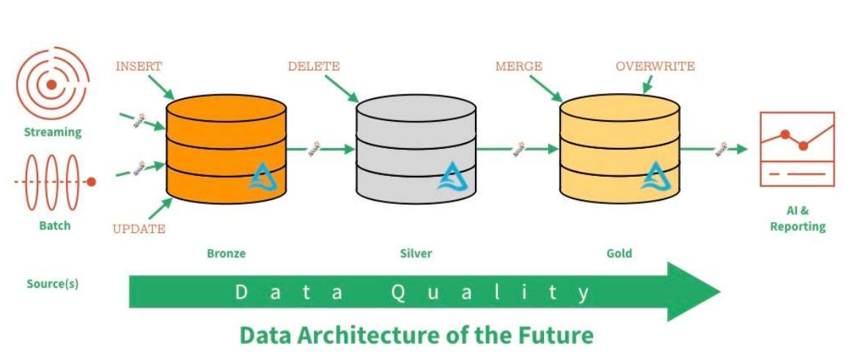
Data Lake – Zones & Data Quality

Slide 7
Various File Types
Weakly typed file formats can lead to data quality and ETL pipeline issues. For instance, a delimited file type as Comma Separated Values (CSV) can be easily broken. This file type does not allow for compression.
Strongly typed file formats can lead to better data quality and the least amount of ETL pipeline issues. For instance, an Apache Parquet file format is stored as binary data, contains columns names/types and allows for compression of the data.

Slide 8
Load Patterns
The full load design pattern involves replacing the target dataset with a completely new version. Use this pattern with small sized data.
An incremental load design pattern involves merging the target dataset with a small dataset the represents changes over a given time period. For instance, a daily update file. This pattern can be used with small to medium sized data.
For the largest datasets, the use of a partitioning allows the full or incremental patterns to work with a subset of the data.

Slide 9
Delta File Format – Uses parquet files +
ACID transactions make sure complete writes are committed.
Schema enforcement allows only clean data inserted into the lake.
Time travel allows for versioning the delta lake table. Thus, we can view data at any given point.
Snapshot isolation allows for multiple readers and writers.
Open-source format that is built for distributed systems such as Spark.

Slide 10
What is data engineering?
Quote from Wikipedia – “Data engineering refers to the building of systems to enable the collection and usage of data.”
Spark.Read – read file from storage into dataframe
PySpark library – either use dataframes or SQL to transform data
Spark.Write – write dataframe to storage

Slide 11
Before Workflows
Create parent notebook
Create child notebook
Run child with parameters
Schedule job to execute parent
Pros: Simple design pattern.
Cons: Hard to enforce constraints between notebook calls.
Hard to alert on failure.
Example 1 – Calls embedded in Parent Notebook

Slide 12
After Workflows
Create child notebook
Create job (workflow)
Create tasks (calls to child notebook)
Schedule job to execute
Pros: Simple design pattern.
Easy to enforce constraints tasks.
Easy to add email alerting.
Example 2 – Notebook executions are workflow tasks

Slide 13
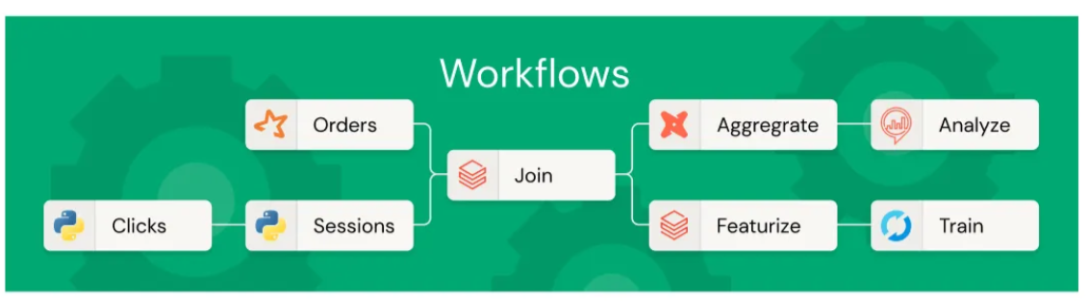
What can be a task?
Code – notebook, python script, python wheel, jar, spark submit
SQL – dashboard, query, alert, SQL file
Transformation – DLT pipeline, dbt
Control flow – run job

Slide 14
Autoloader - Details
File Detection Mechanism
File list – light weight for light traffic
Notification service – heavy duty for huge traffic
Rocks DB
Key value store for incoming files
Checkpoint files for restart-ability
Streaming
Using similar syntax
More scalable and reliable

Slide 15
Autoloader - Details
External process drops files into the raw zone of the data lake.
Autoloader can append data to bronze delta table.
Full load - overwrite silver delta table with latest records
Incremental loads– merge newest records with silver delta table
Pros: Easy to setup.
Cons: Must code for each quality zone.
Can use parameterized notebooks.
Example 3/4 – Create JSON files, Autoload Data

Slide 16
Delta Live Tables - Details
Supports files, event hubs and databases
Has two syntaxes.
Python (declarators)
Spark SQL
Use GUI interface plus notebooks to create pipeline
Can be run as batch or streaming.
Supports materialized views
Pros: Easy to setup. Built in monitoring/logging.
Cons: Must get used to new syntax.
All data resides in one database (schema)
Example 5 – Example of pipeline

Slide 17
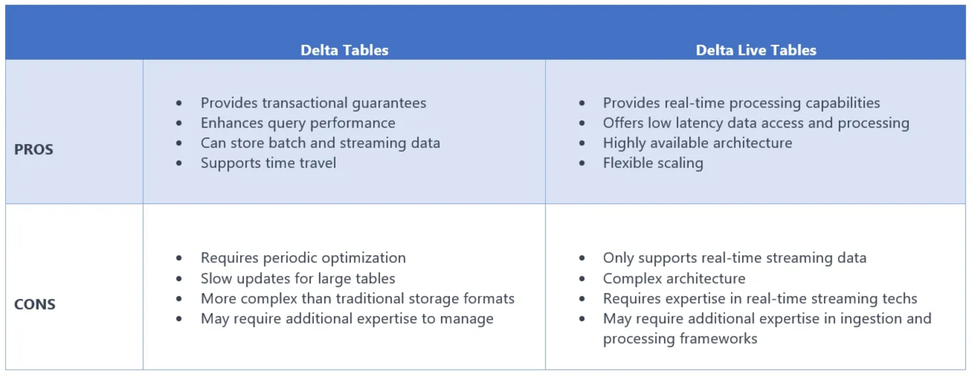
Delta Live Tables (DLT)
Lackshu Balasubramaniam – writing @ medium.com

Slide 18
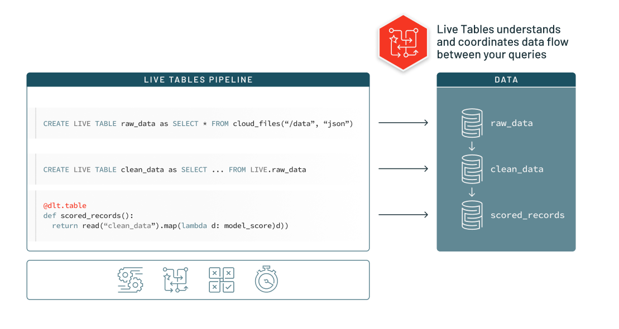
Delta Live Tables – Advance Features
Data Quality
Expect or Fail expressions
label data as valid or invalid
Change Data Capture
SCD Type 1 - overwrite
SCD Type 2 – effective dating

Slide 19
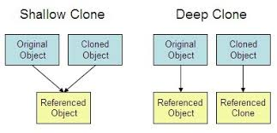
Delta Clones
Shallow Clone
Copies over meta data
Uses original source files
Deep Clone
Copies over meta data
Copies over source files
Optionally keeps files in synch (DR)

Slide 20
Summary
The Databricks product has matured over the years.
In the past, we used to create parametrized notebooks to transform our files in the lake. Today, we have two new choices to load data: autoloader and delta live tables.
The autoloader pattern allows for quick ingestion of files using either batch or streaming. This gives the developer fine grain control of the code used in the solution.
The delta live tables pattern has abstracted many of the details away from the developer. If you are used to SQL, there is syntax to get you up and running in not time.
Finally, delta cloning is great for making point in time copies of the data or placing a read only copy of the data into a lower environment. The future is bright for data engineers who can adapt to the changing environment.

Slide 21
References
Databricks Company
https://tinyurl.com/yc2wfd55
Delta Lake – Press Release
https://tinyurl.com/2xcn2v4x
Delta Lake
https://tinyurl.com/32z8zkrf
Spark Pipelines
https://tinyurl.com/3fxtn952
Databricks Workflows
https://tinyurl.com/fn7ebw3h

Slide 22
References (continued)
Autoloader
https://tinyurl.com/33nn3tuj
Delta Live Tables
https://tinyurl.com/4dvm7trm
DLT Article - Medium
https://tinyurl.com/3fav3dwa
Delta Clones
https://tinyurl.com/mrxkabb3
Cloning for DR
https://tinyurl.com/5fd7rt6v

Slide 23
Questions / Thank You

